Slide 1
INTEGERS
CLASS VI

Slide 2
DEFINATION OF INTEGERS
COLLECTION OF WHOLE NUMBERS ALONG WITH POSITIVE AND NEGATIVE SIGN IS CALL INTEGERS
TYPES OF INTEGERS
NEGATIVE INTEGER
POSITIVE INTEGERS

Slide 3
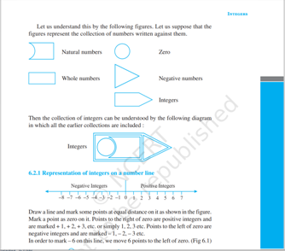
REPRESENTATION OF INTEGERS

Slide 4
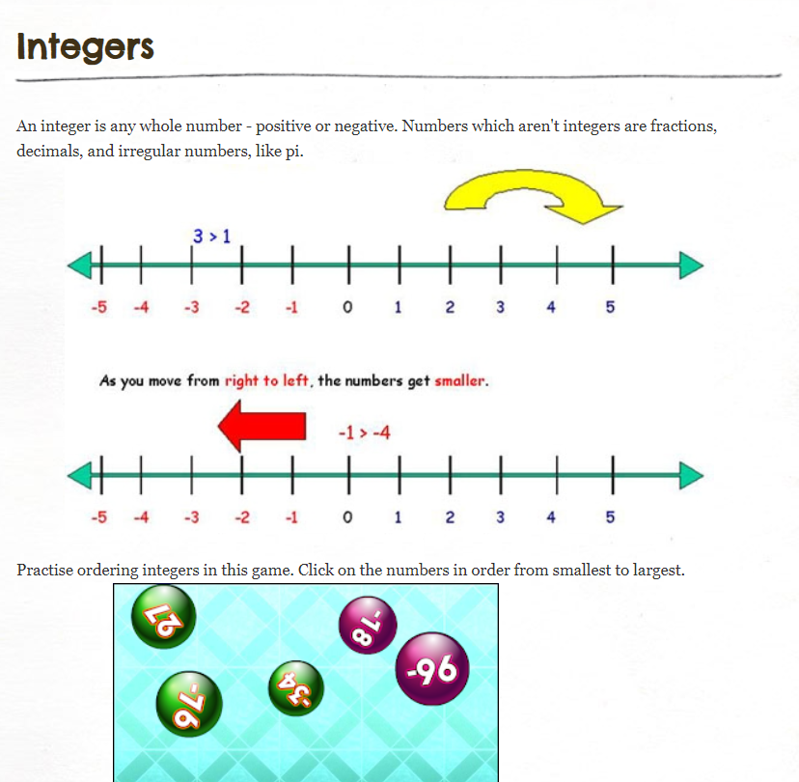
ORDERING OF INTEGERS

Slide 5
NEGATIVE INTEGERS
WHOLE NUMBERS ALONG WITH NEGATIVE SIGN IS CALLED NEGATIVE INTEGERS
FOR EXAMPLE
... -6,-5,-4,-3,-2,-1,0,1,2,3,4,5,6....

Slide 6
POSITIVE INTEGERS
WHOLE NUMBERS ALONG WITH POSITIVE
SIGN IS CALLED POSITIVE INTEGERS
....0,1,2,3,4,5,6,7,8

